Slide 1


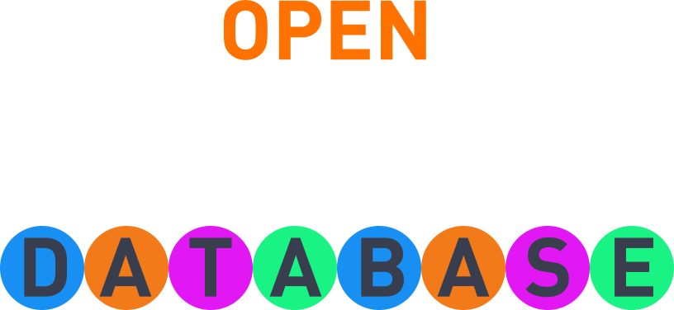


Quizz

Slide 2
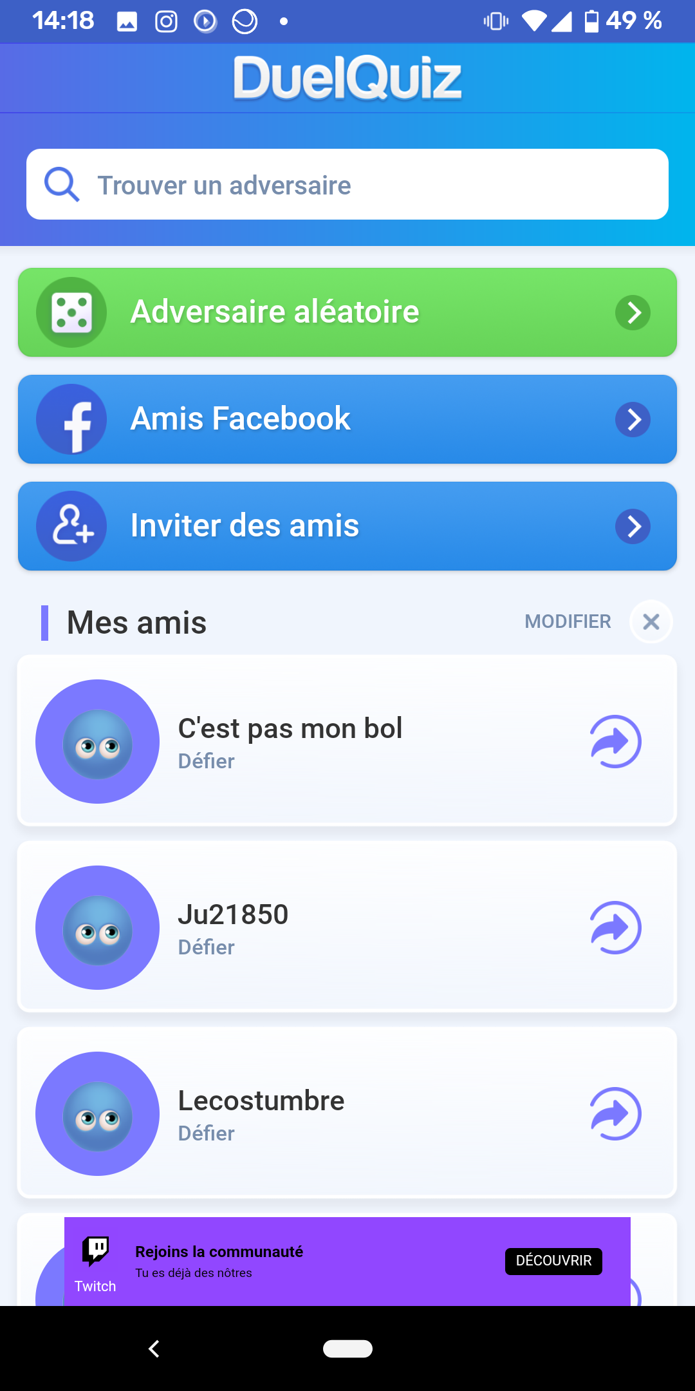
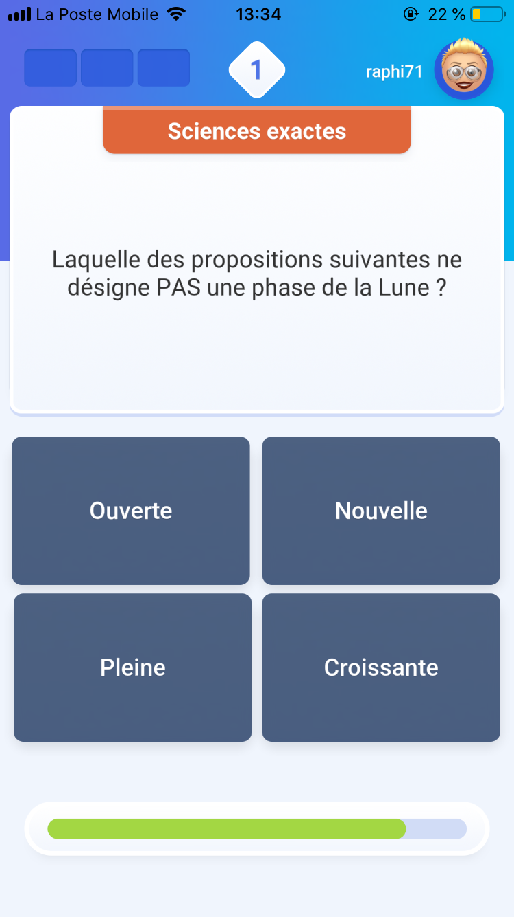
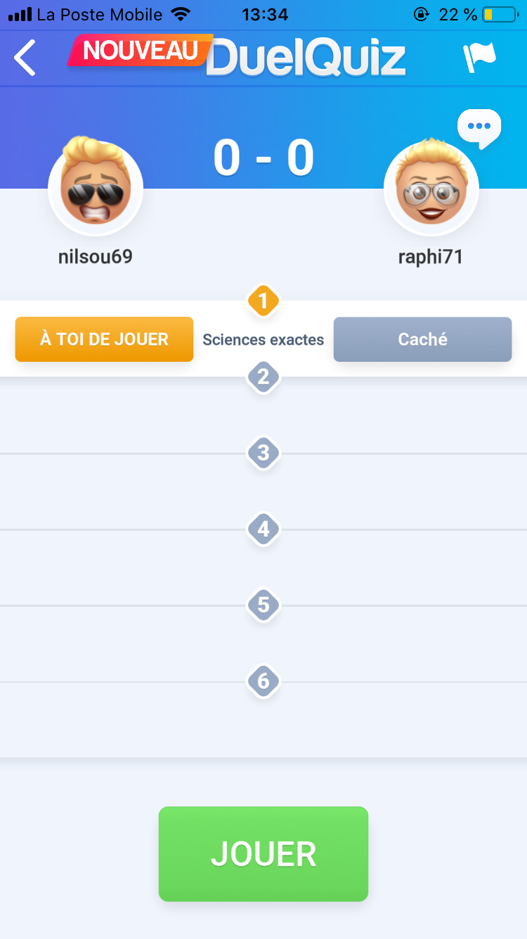
Design app

Slide 3






Produits Firebase
RealTime DataBase
Firestore
Cloud Functions
Cloud Storage
Cloud Messaging
Firebase Auth

